Slide 1
taint
In Terraform, the taint command is used to mark a specific resource managed by Terraform as tainted. This means that Terraform will consider the resource as needing to be destroyed and recreated on the next apply operation. Tainting a resource is useful in scenarios where you suspect that the resource configuration has become incorrect or out-of-sync due to manual changes or errors, and you want Terraform to recreate it to bring it back to the desired state defined in your Terraform configuration.

Slide 2
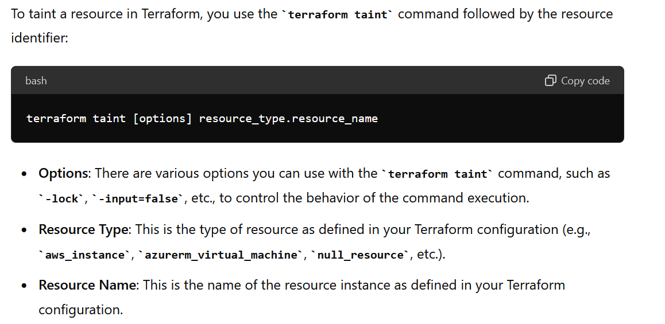

Slide 3
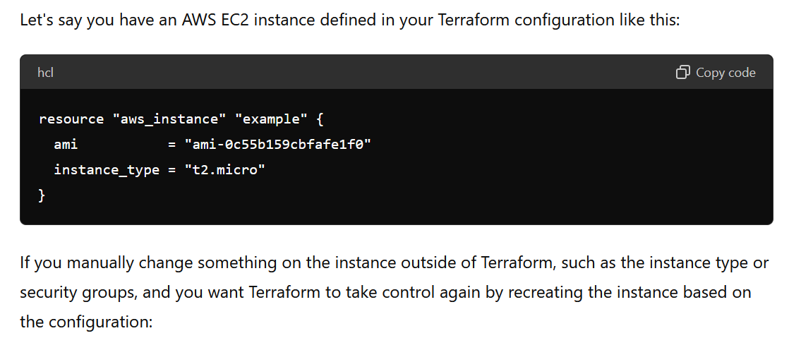

Slide 4
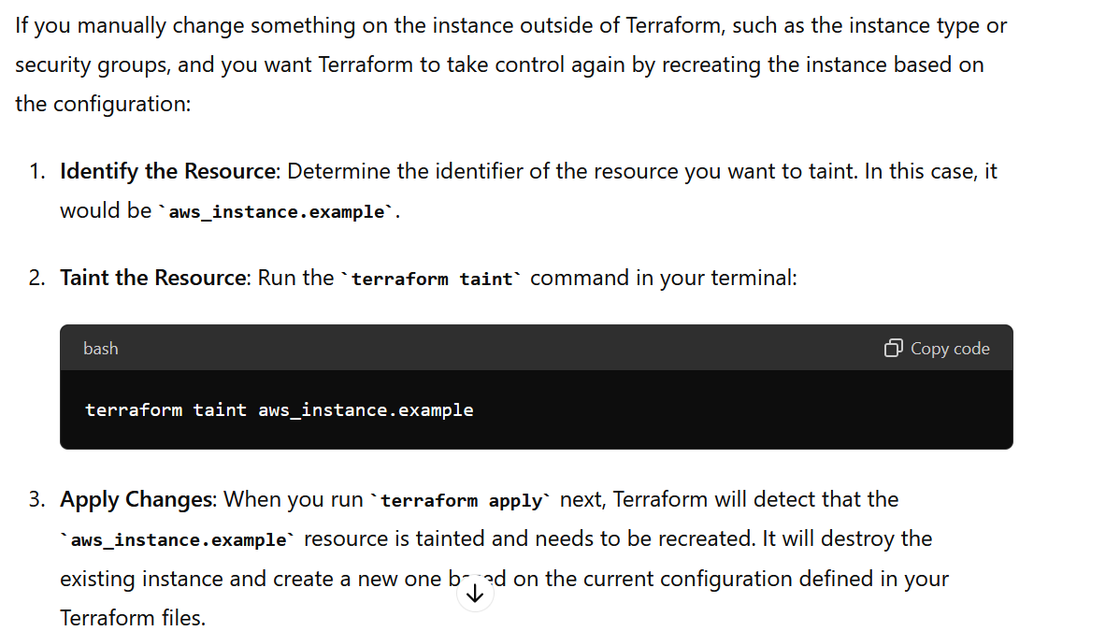

Slide 5
Summary
The terraform taint command is a tool in Terraform that helps maintain the desired state of infrastructure defined in your configuration files. By marking a resource as tainted, Terraform will manage it during the next apply operation by recreating it based on the current configuration, ensuring consistency and adherence to your infrastructure-as-code principles. Use it cautiously and understand its implications to avoid unintended disruptions in your infrastructure.

